Slide 1


Slide 2


VAKGROEP TELECOMMUNICATIE EN INFORMATIEVERWERKING
ONDERZOEKSGROEP IMAGE PROCESSING AND INTERPRETATION
Multimedia – Labo 2
Gianni Allebosch, Martin Dimitrievski
{gianni.allebosch, martin.dimitrievski}@ugent.be
Master of Science in de industriële wetenschappen: elektronica-ICT Campus Ardoyen,
BE - 9000 Gent

Slide 3
TIPS & TRICKS
Keep your program user friendly!
Provide a README.txt
Execute each exercise sequentially in 1 script
Make clear which exercise is currently being executed
Name your windows when showing images
If input is required from the user, make sure the instructions are clear
●

Slide 4
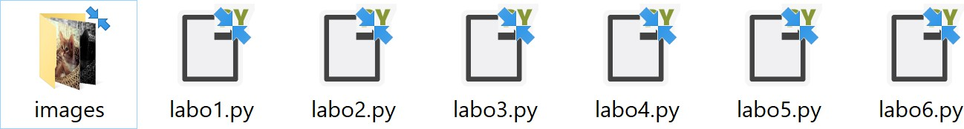
TIPS & TRICKS
Be sure the code is executable as is!
We will not change your code!
Functions in comments will not be executed
Store all input images in a folder named “images” next to your code
●
– Do not use absolute paths but use relative paths (portability!):
✗ “C:/users/admin/multimedia/labo1/images/lena_color.jpg”
✔ “images/lena_color.jpg”

Slide 5
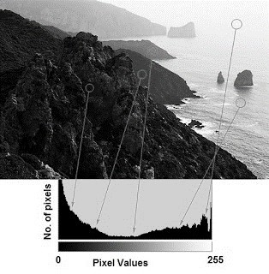
HISTOGRAMS
A histogram shows for every intensity value/range the amount of pixels present in the image with that same intensity value/range.

Slide 6
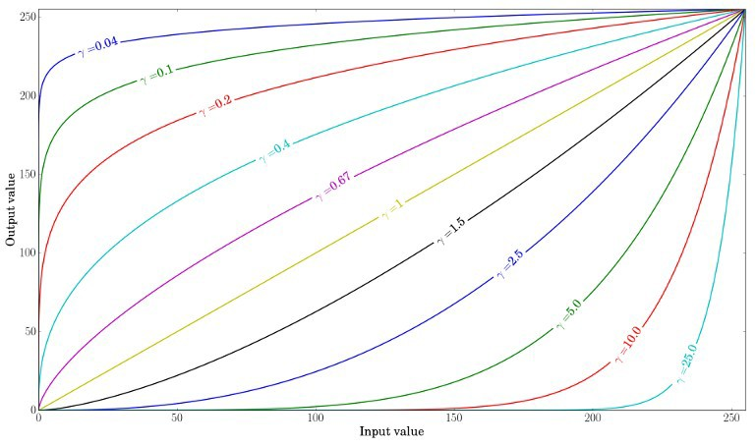
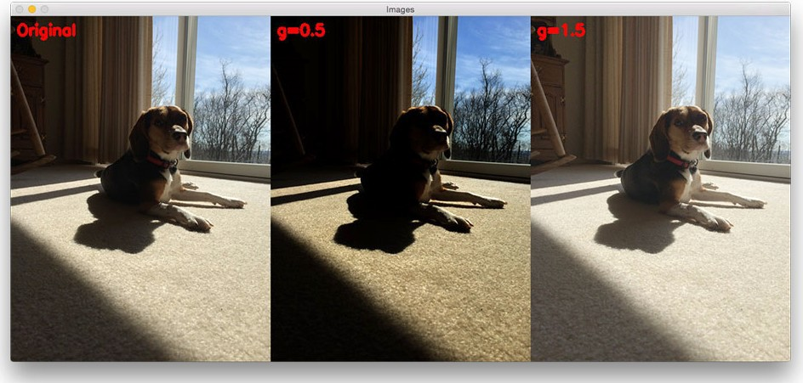
GAMMA TRANSFORMATION
Gamma transformations are non-linear operations on the intensity values of the pixels. They can enhance the contrast in the dark or the light areas of the image. The effect depends on γ.

Slide 7
Question – Intensity, contrast and gamma
Solve the question in your README.txt
For which values of γ is the contrast in dark zones enhanced?
For which values of γ is the contrast in light zones enhanced?
●

Slide 8
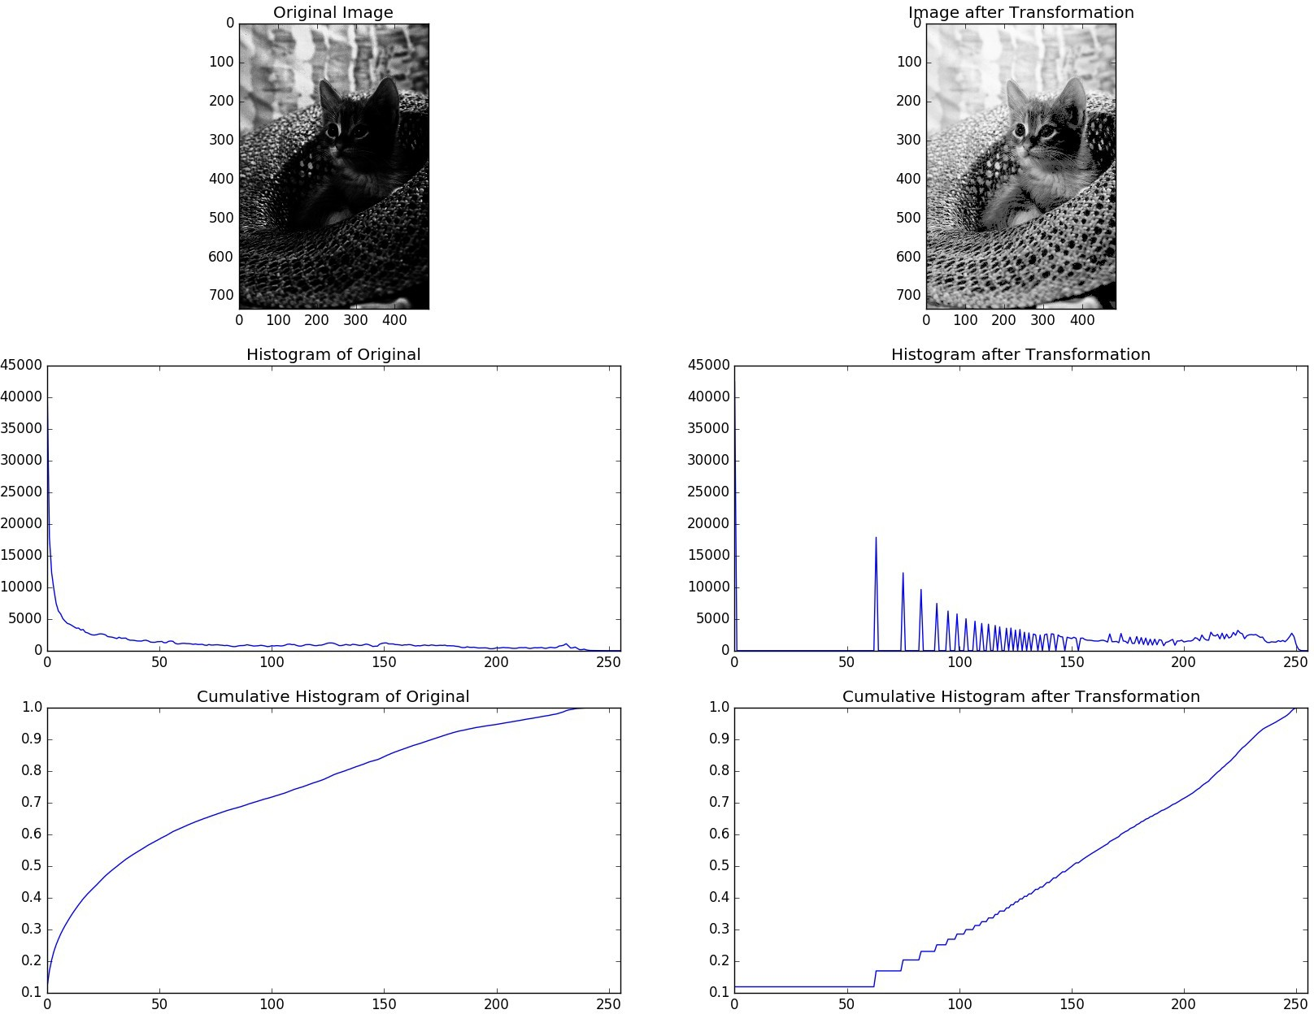
Exercise 1 – Gamma Transformation

Slide 9
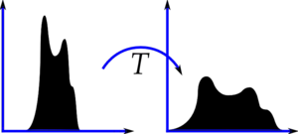
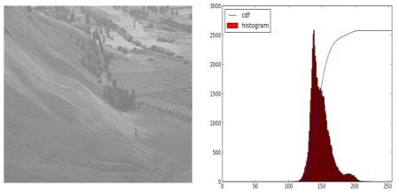
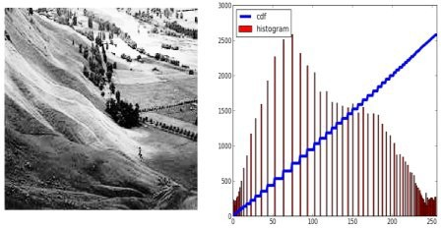
HISTOGRAM EQUALIZATION
Histogram equalization is a simple form of contrast enhancement.

Slide 10
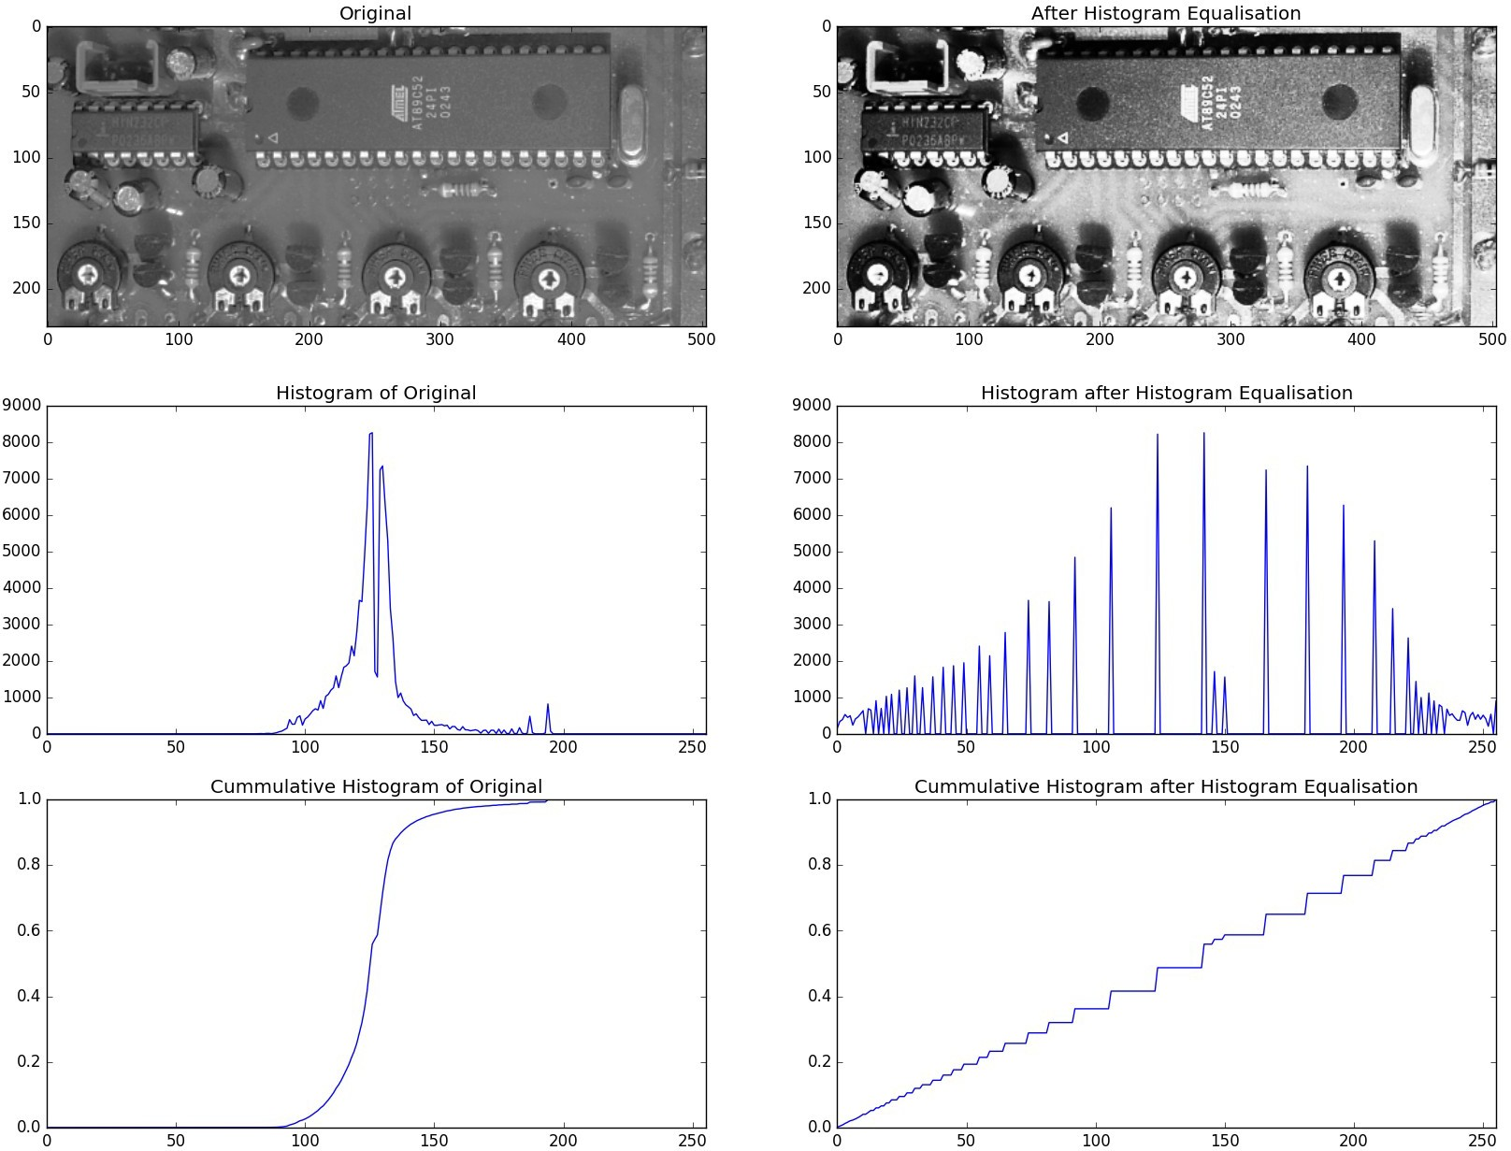
Exercise 2 – Histogram Equalization

Slide 11
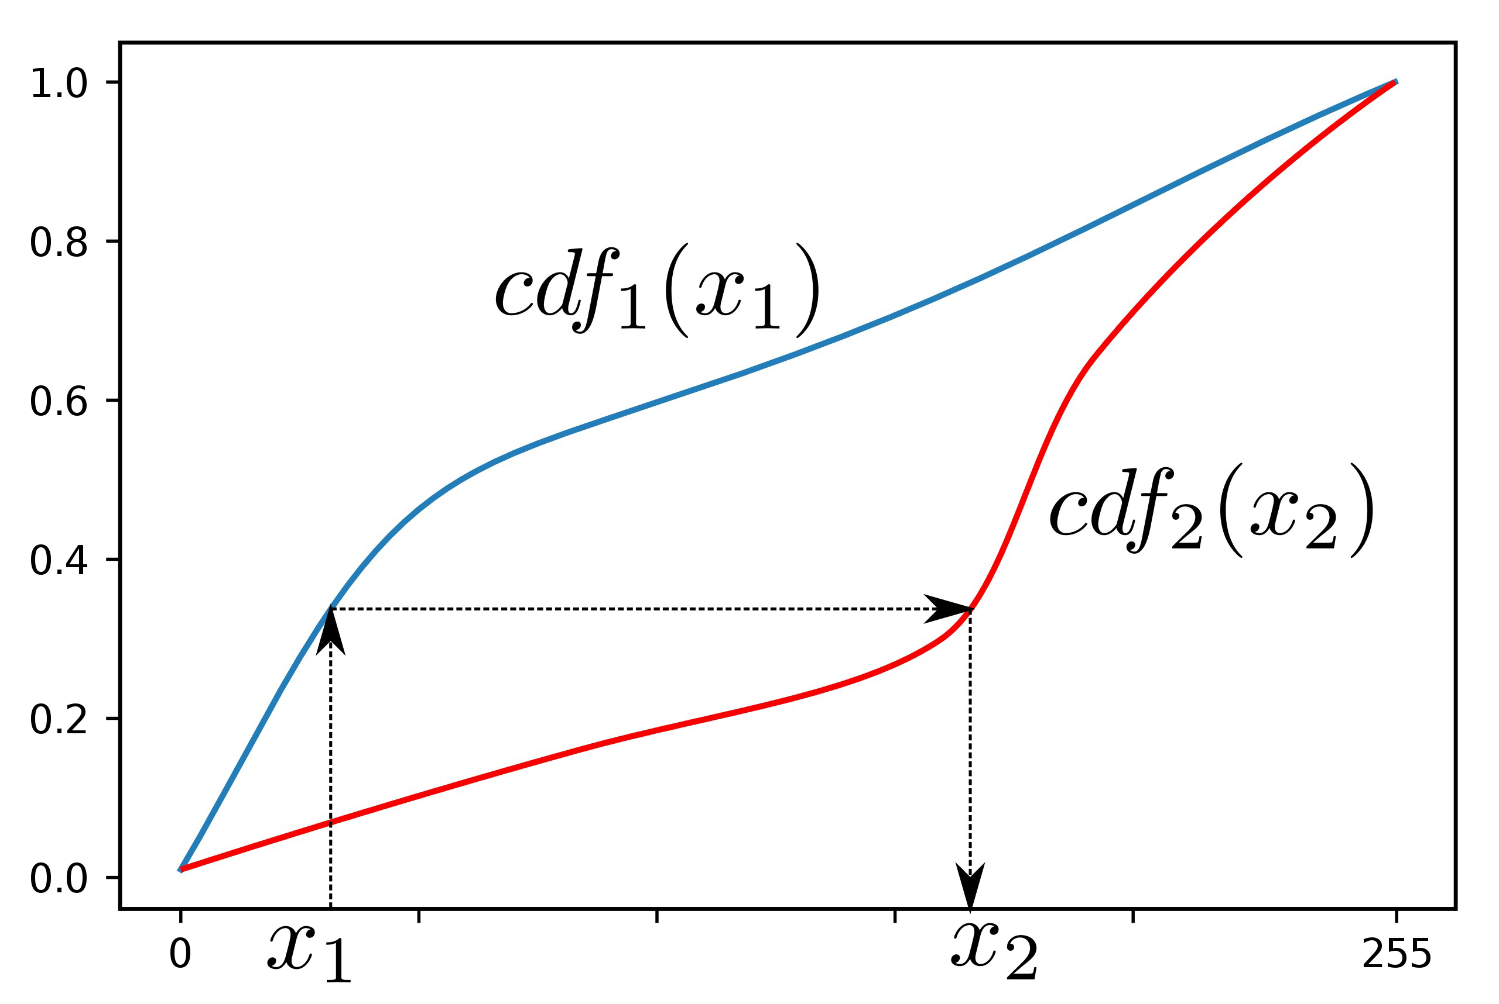
HISTOGRAM MATCHING
In histogram matching, a histogram of one image is transformed to approach the histogram of another image.
In this example, the cumulative histogram of image 1 is transformed to match the cumulative histogram of image 2. A pixel with intensity value x₁ is
remapped to intensity value x₂.

Slide 12
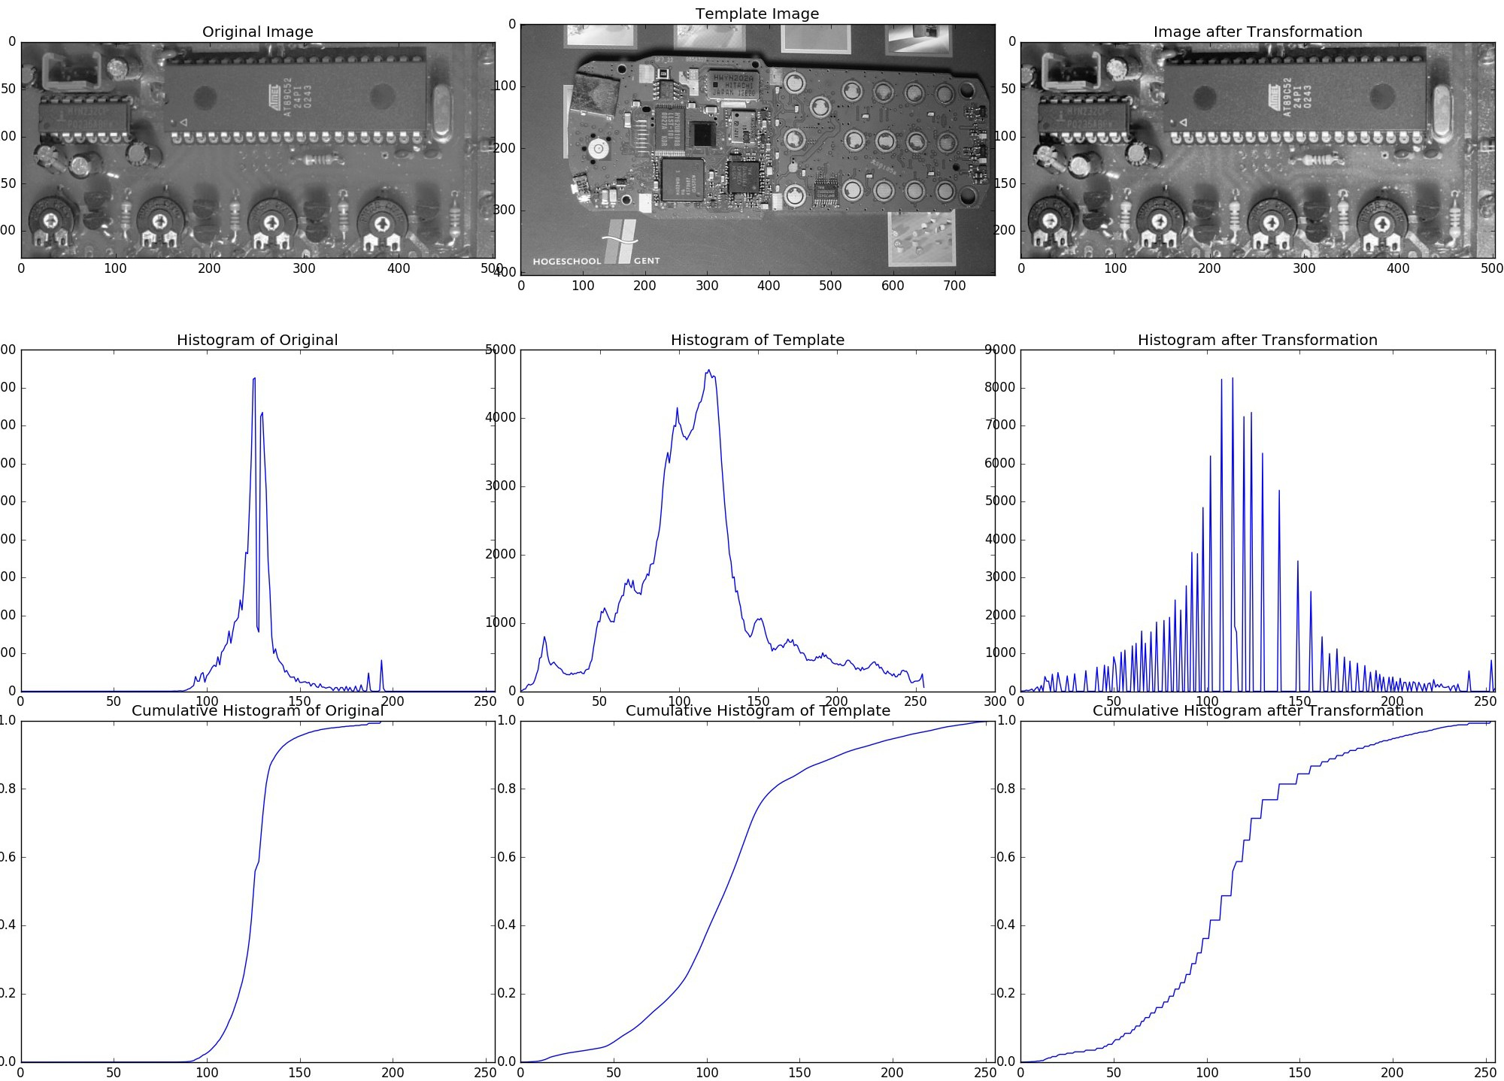
Exercise 3 – Histogram Matching

Slide 13

AVERAGING FILTER
104 | 100 | 97
102 | 105 | 95
105 | 99 | 93
Sum of pixels = 900
Average = 100 = new pixel value

Slide 14
MEDIAN FILTER
104 | 101 | 97
102 | 104 | 95
105 | 99 | 93
104 | 101 | 97
102 | 104 | 95
105 | 0 | 93
Average = 100
Median = 101
Average = 89
Median = 101

Slide 15
Question – Spatial Filters
Solve the question in your README.txt
Discuss the advantages and disadvantages of the averaging filter, the influence of the filter size and why the sum of the filter must be 1.
– Discuss the advantages and disadvantages of the Gaussian filter in regards to the averaging filter. Discuss the influence of the filter size.
–

Slide 16

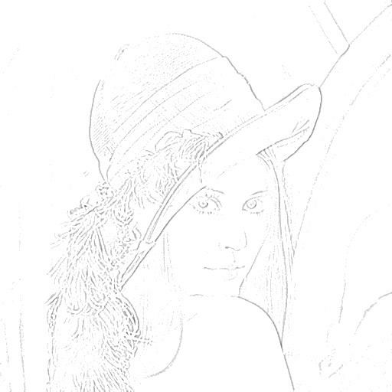
Exercise 4 – Pencil

Slide 17
TIPS & TRICKS
Deliver your working code before next session
Opdrachten on Ufora
1 python script named labo#.py
README.txt (see example)
output.zip with every output image
●

Slide 18
TIPS & TRICKS
Questions or need help? Contact us at:
gianni.allebosch@UGent.be AND Martin.Dimitrievski@UGent.be
●

Slide 19
VAKGROEP TELECOMMUNICATIE EN INFORMATIEVERWERKING
ONDERZOEKSGROEP IMAGE PROCESSING AND INTERPRETATION
GOOD LUCK!

